Slide 1
Web3 & blockchain
GROUP NUMBER: 04
MANISH KUMAR(2001CS45)
GONNABATTULA SOWJANYA KUMAR(2101CS85)
ASIF HUSSIAN(2101CS13)
AMIT KUMAR YADAV(2101CS09)
COURSE NAME: BLOCKCHAIN & CRYPTOCURRENCY(CS577)
COURSE INSTRUCTOR: RAJU HALDER

Slide 2
INTRODUCTION
Web3 and blockchain are revolutionizing the internet by shifting control from centralized authorities to individual users, ensuring greater transparency, privacy, and ownership of digital assets.“
Blockchain technology underpins many Web3 applications, including cryptocurrencies like Bitcoin and Ethereum,"
Web3 applications depend on blockchain as the core technology that allows them to work effectively without central authorities.

Slide 3
project
Project of that topic we have chosen is Krypt- Web 3.0 Blockchain Application
Tools required for this project are :
Krypt-Web3.0 having smart contracts for transactions using React, Nodejs and
for webpage using HTML, CSS, JS to get it transparency, immutable and
decentralized authorities.
With the help of Metamask we are available to see our transaction after sending
ether(cryptocurrency of ethereum) to another address like account number.

Slide 4
ABOUT THE PROJECT
The project involves transferring Ether from one address to another, similar to transferring money between account numbers using platforms like Google Pay, PhonePe, Paytm, and so on.
Here, we are using a web application platform called Krypt Web3.0 Blockchain application.
This platform is efficient, transparent, and immutable, allowing us to send Ether from one address to another with ease.

Slide 5
ETHEReUM
Ehereum is an open-source, decentralized blockchain platform that enables developers to build and deploy smart contracts and decentralized applications(dApps).
It was created by Vitalik Buterin in 2015 with the goal of expanding blockchain’s potential beyond Bitcoin's capabilities of digital currency and transactions, offering a "world computer" that could be used for programmable applications.

Slide 6
KEY ASPECTS OF ETHEReUM
Smart Contracts:
Smart contracts are self-executing contracts with code defining the terms and conditions, which automatically execute transactions or actions when predefined conditions are met.
Ether (ETH):
Ether is the native cryptocurrency of the Ethereum network. It serves multiple purposes, including paying for computational resources and transaction fees on the network.
1 ETHER = 2,59,209 INR according to google.

Slide 7
CONTINUE
ETH is also used as "gas," which represents the cost of executing operations on the Ethereum blockchain. More complex operations consume more gas, and gas fees fluctuate based on network demand.
Consensus Mechanisms:
Originally, Ethereum used Proof of Work (PoW) to secure its network, similar to Bitcoin, which required miners to solve complex puzzles to validate transactions.

Slide 8
CONTINUE
In September 2022, Ethereum transitioned to Proof of Stake (PoS) with an upgrade known as "The Merge," where validators are chosen to confirm transactions based on the amount of ETH they have staked. This made Ethereum significantly more energy-efficient and laid the foundation for future scalability improvements.
Ethereum Virtual Machine (EVM):
The EVM is a runtime environment that executes smart contracts and dApps on the Ethereum network.

Slide 9
CONTINUE
It enables developers to write code in a variety of programming languages, most notably Solidity, and deploy it to the blockchain where it can be executed in a secure, decentralized manner.
Decentralized Applications (dApps):
dApps are applications built on the Ethereum blockchain that operate without a centralized server or authority. Common examples of dApps include decentralized finance (DeFi) applications, where users can lend, borrow, and trade assets, as well as gaming platforms, marketplaces, and more.

Slide 10
CONTINUE
Ethereum 2.0 and Scalability
Ethereum 2.0, or "Eth2," is an upgrade plan for Ethereum designed to improve scalability, security, and sustainability.
Key features include sharding (dividing the network into smaller segments, or shards, to increase throughput) and further optimizations to make Ethereum more accessible and cost-effective.

Slide 11
CONTINUE
Use Cases:
DeFi (Decentralized Finance): DeFi applications allow for decentralized lending, borrowing, and trading, enabling financial transactions without traditional banks.
NFTs (Non-Fungible Tokens): Ethereum is widely used for creating and trading NFTs, unique digital assets that represent ownership of a specific item, art piece, or collectible.

Slide 12
CONTINUE
DAO (Decentralized Autonomous Organizations): DAOs are organizations governed by smart contracts where decisions are made collectively by token holders, without central authority.
Ethereum's versatility, through its support for smart contracts and dApps, has led it to become one of the most influential blockchains, shaping the evolution of Web3 and decentralized technology.

Slide 13
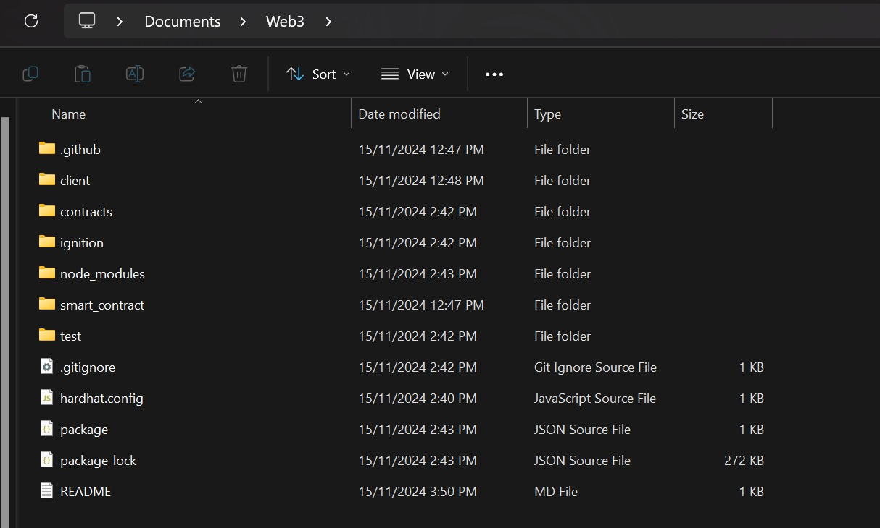
IMPLEMENTATION OF THE PROJECT

Slide 14
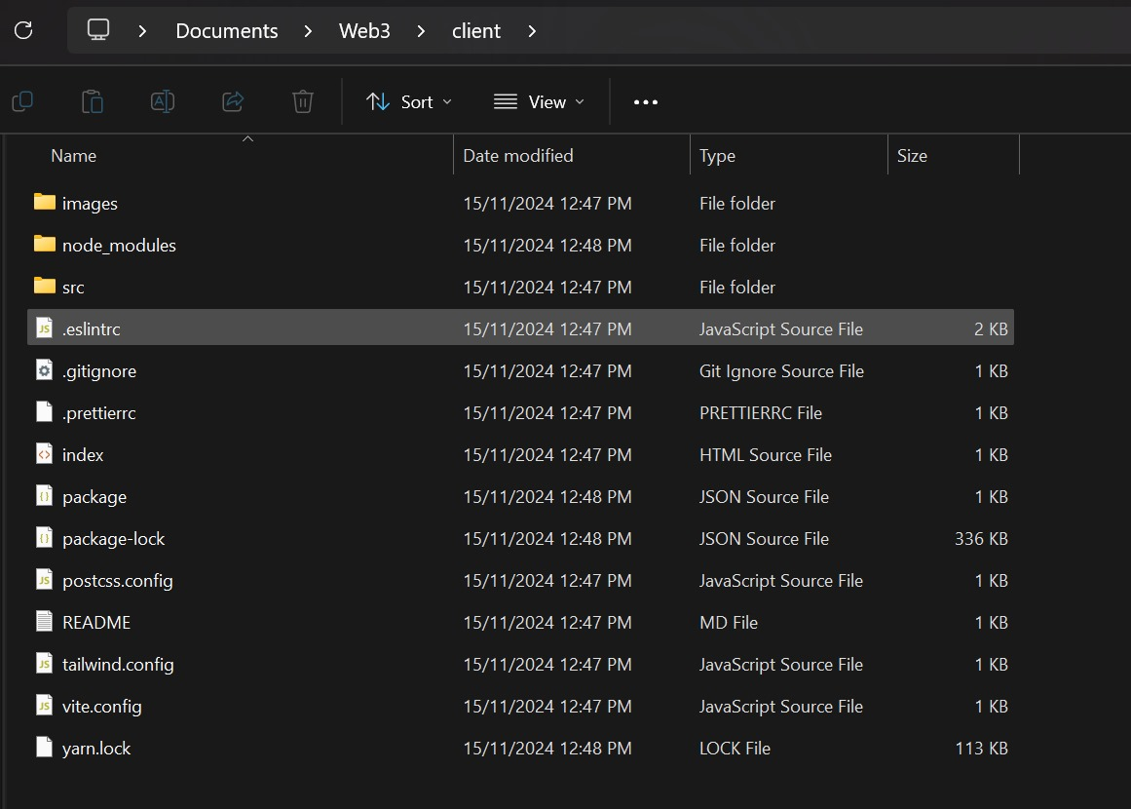

Slide 15
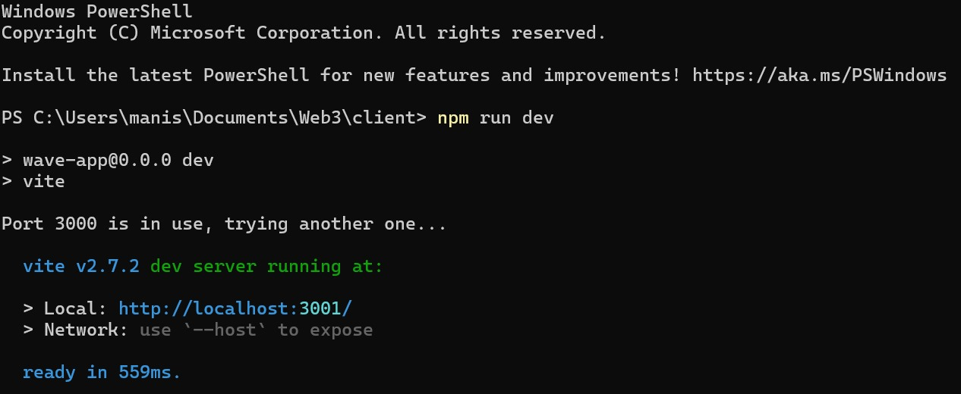

Slide 16
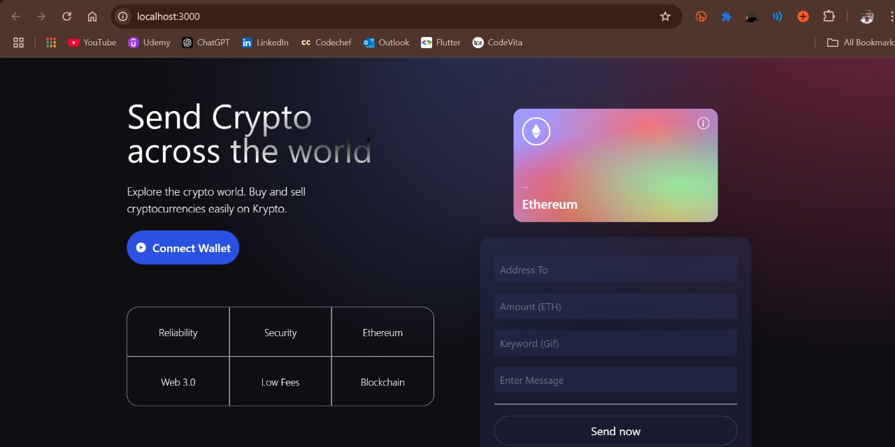

Slide 17
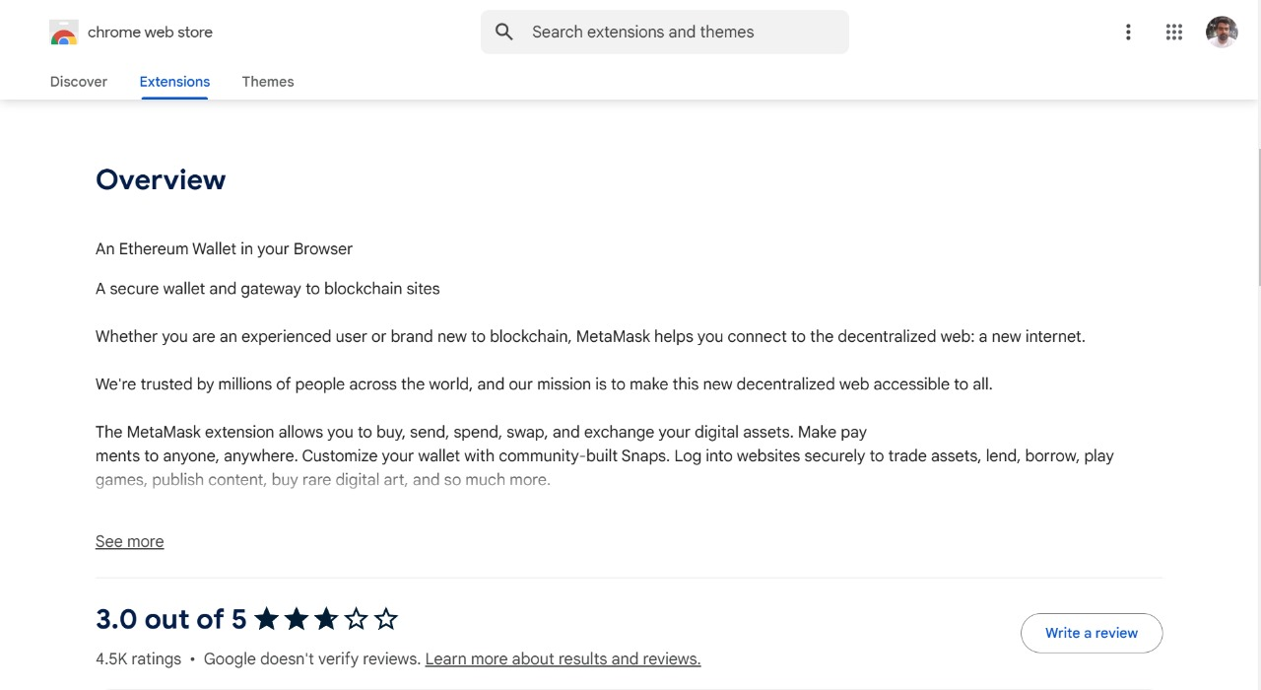

Slide 18
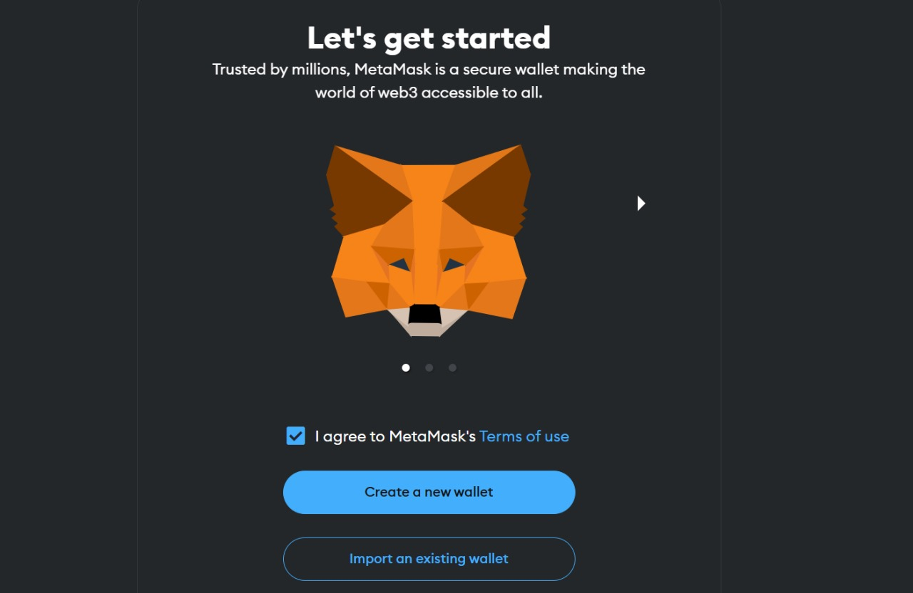

Slide 19
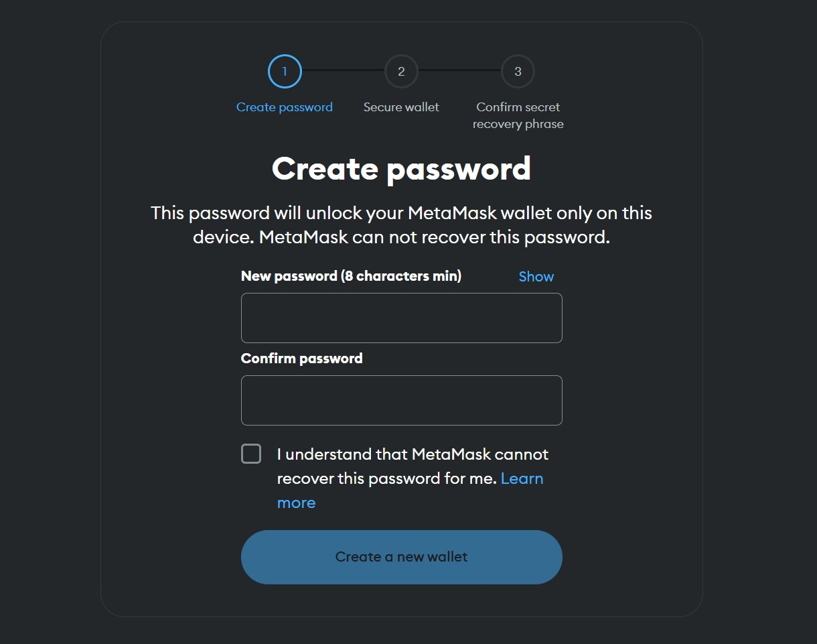

Slide 20
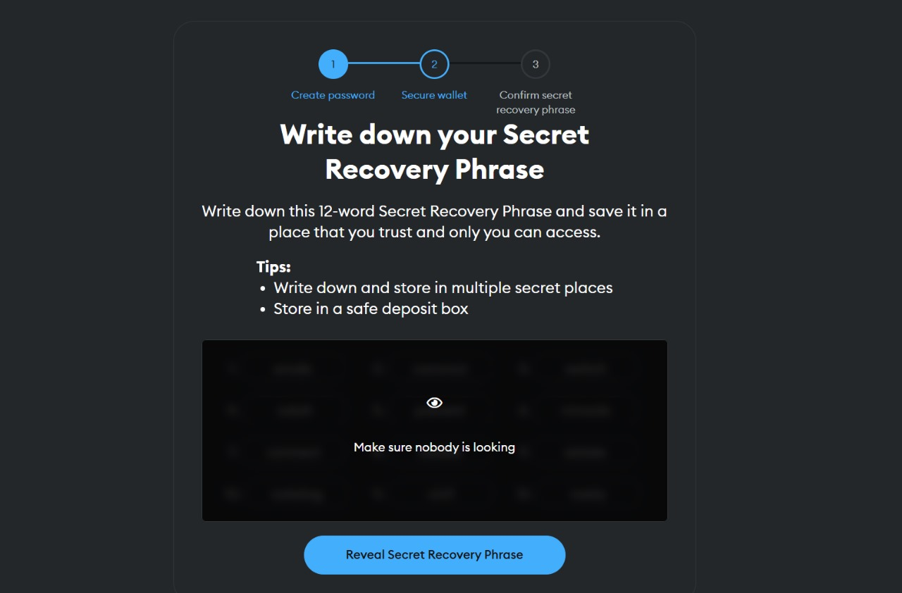

Slide 21
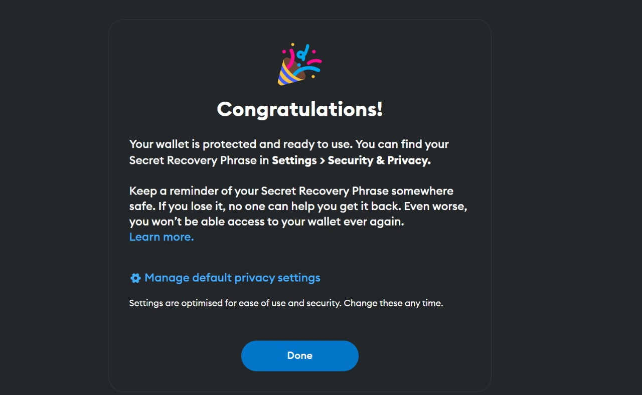

Slide 22
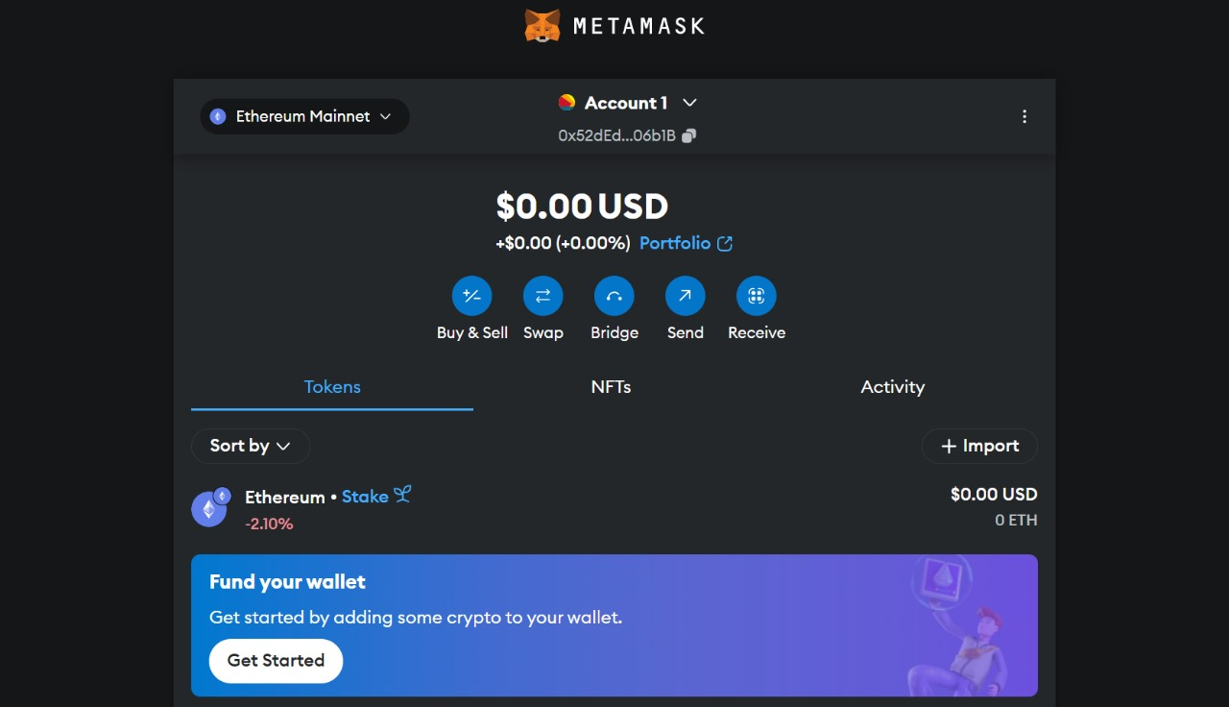

Slide 23
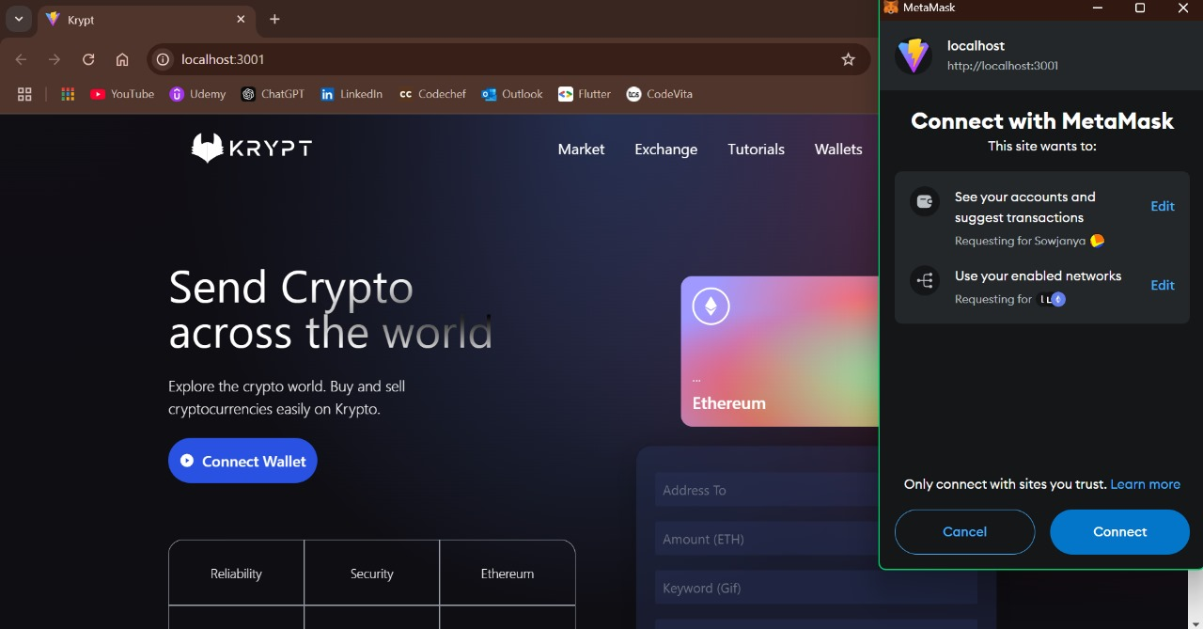

Slide 24
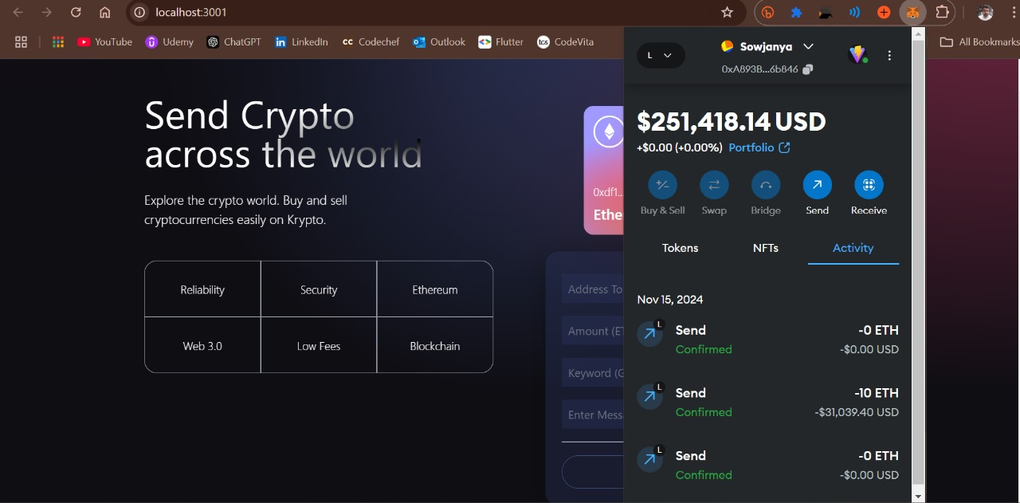

Slide 25
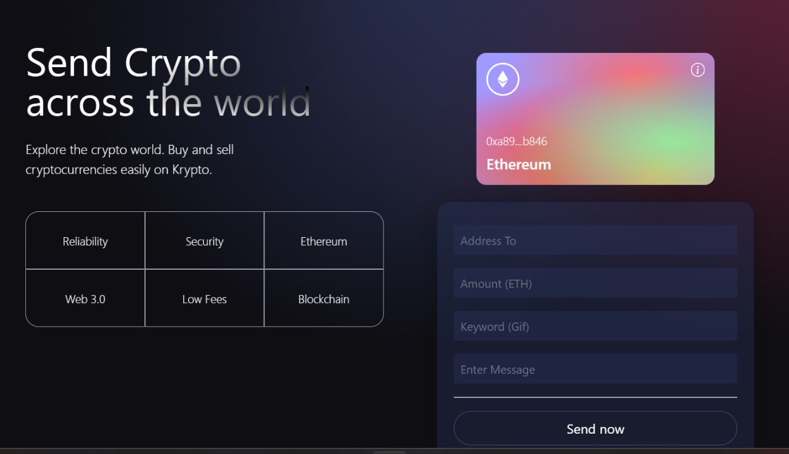

Slide 26
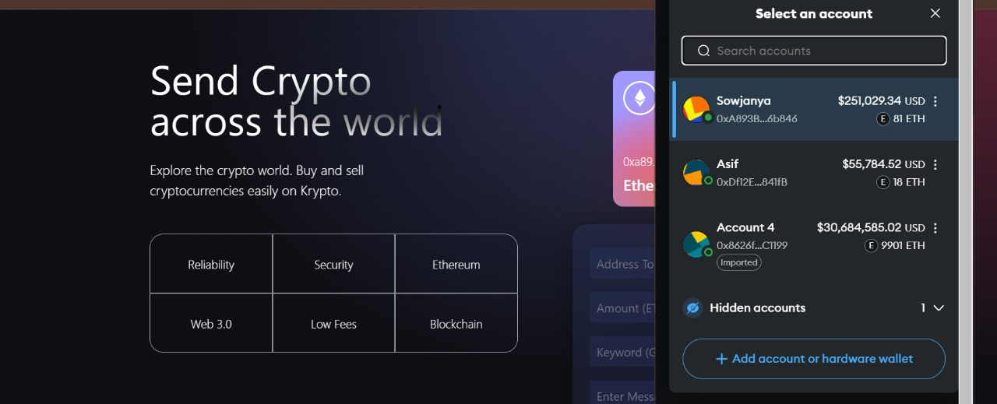

Slide 27
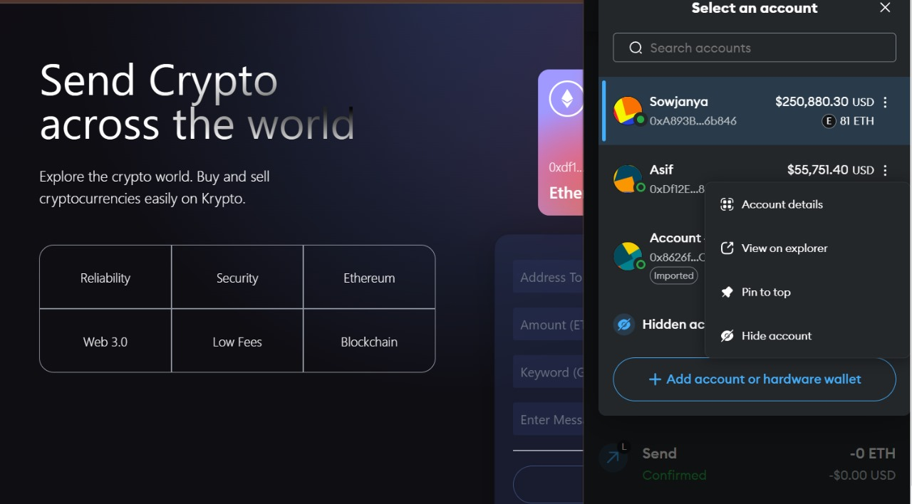

Slide 28
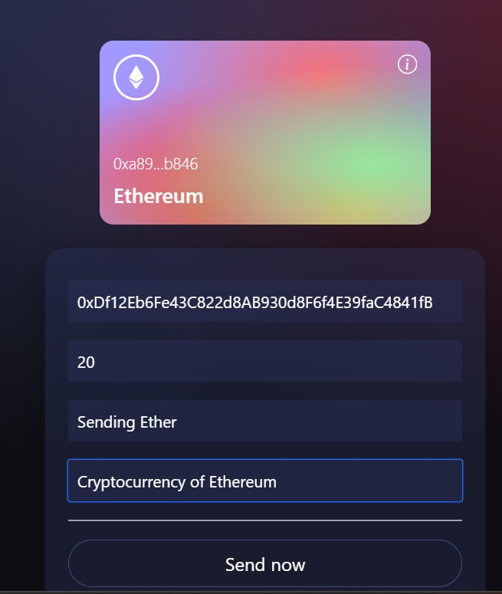
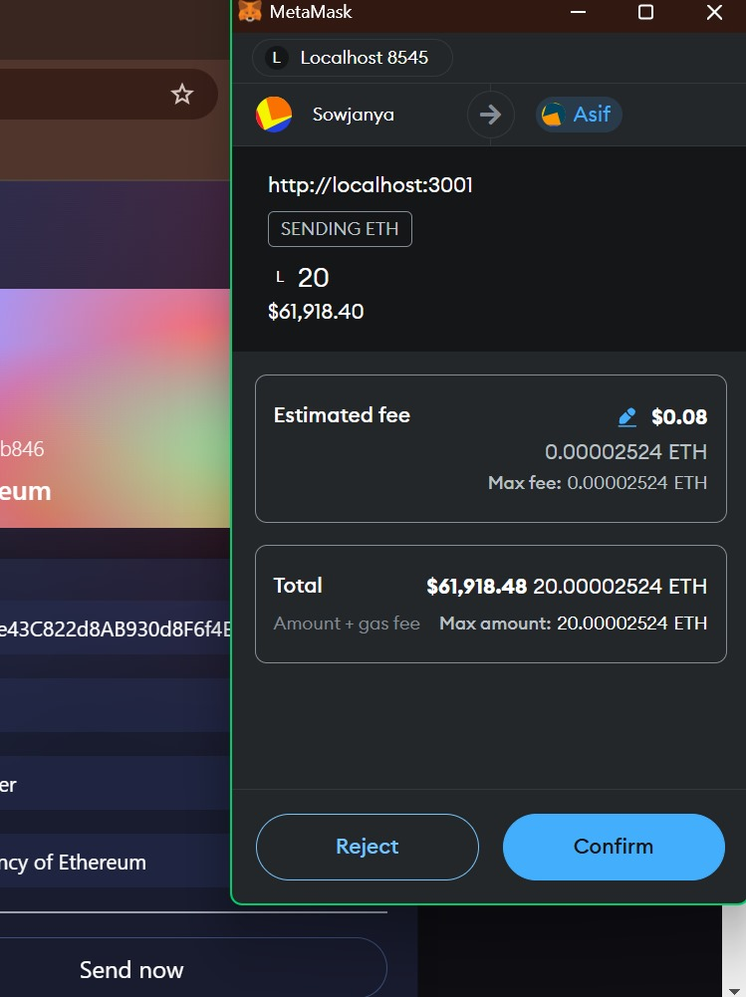

Slide 29
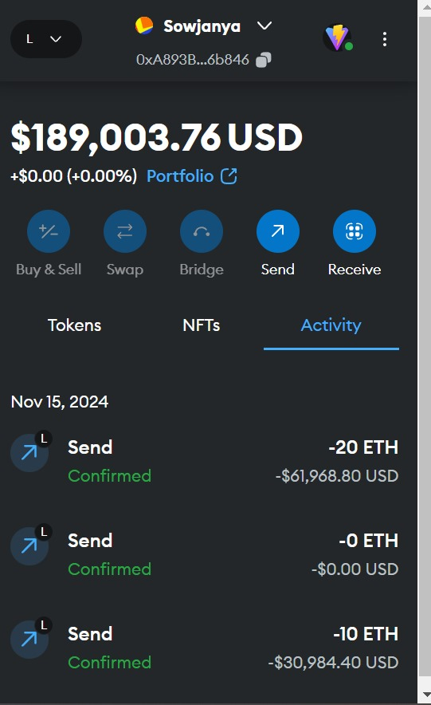
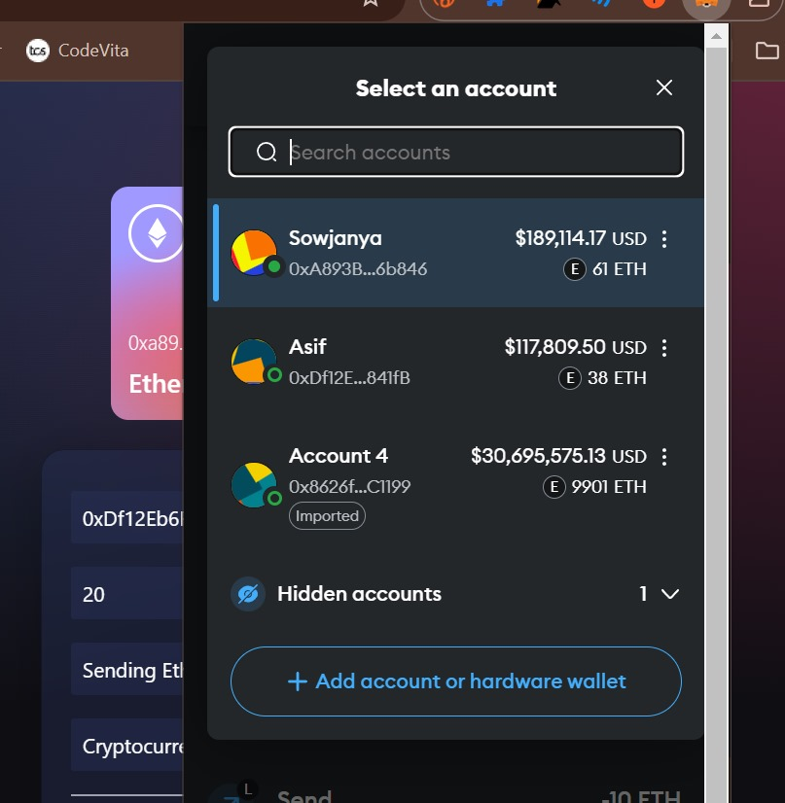

Slide 30
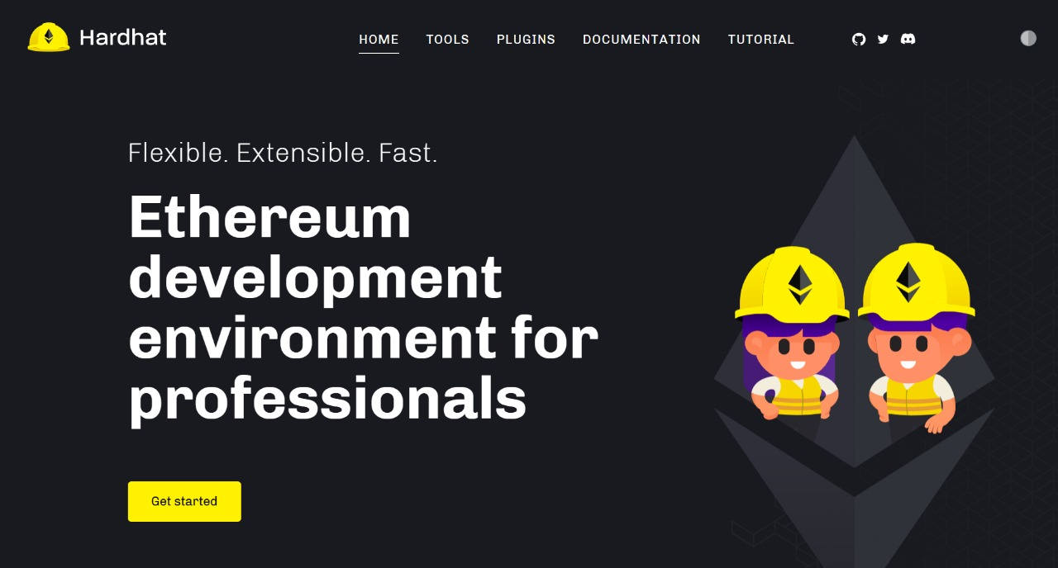

Slide 31
SMART CONTRACTS
A smart contract is a self-executing program stored on a blockchain that automatically enforces and executes terms of an agreement when predefined conditions are met.
It eliminates the need for intermediaries, providing security, transparency, and automation in transactions.
Common use cases include finance (e.g., cryptocurrency payments), supply chain management, and digital identity verification.

Slide 32
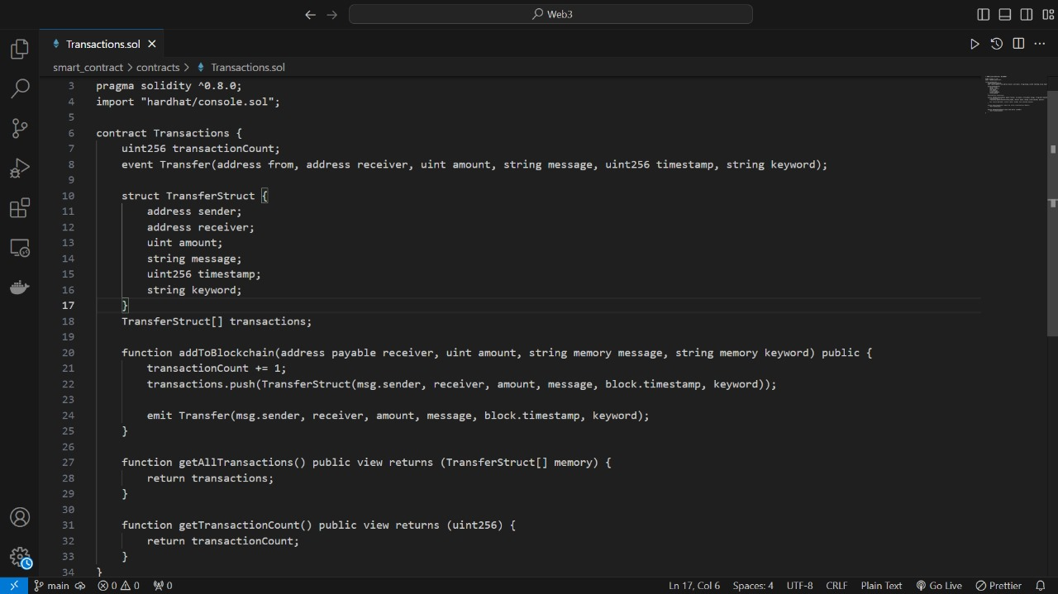

Slide 33
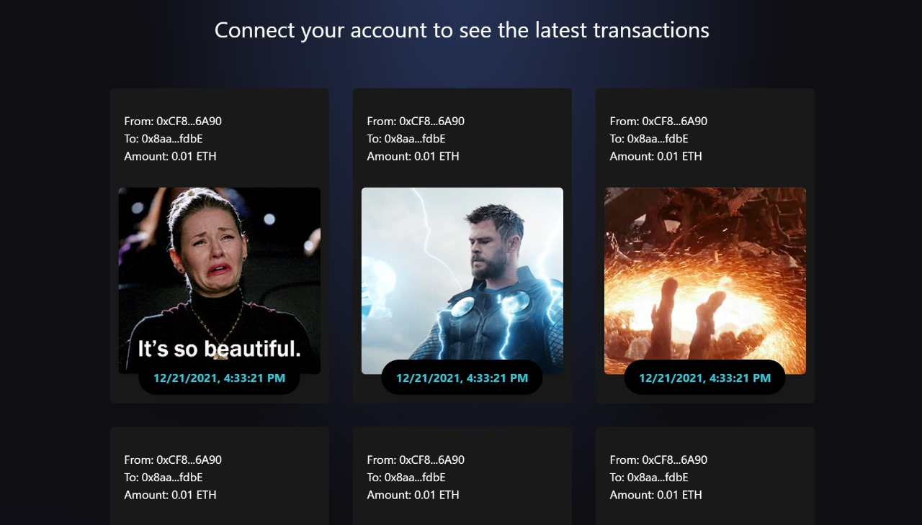

Slide 34




